Slide 2
Absence of Copyright
This slideshow contains photos, diagrams, and information, some of which were attained through internet searches of public websites. The author of this presentation does not own the copyright on this information, so this slideshow is for personal use only—not for sale or profit. Please utilize it to seek the Lord and grow in your knowledge of His Word and ways.
Bro Stan’s Revelation Study is available on our church website:
www.faithprinceton.org

Slide 4
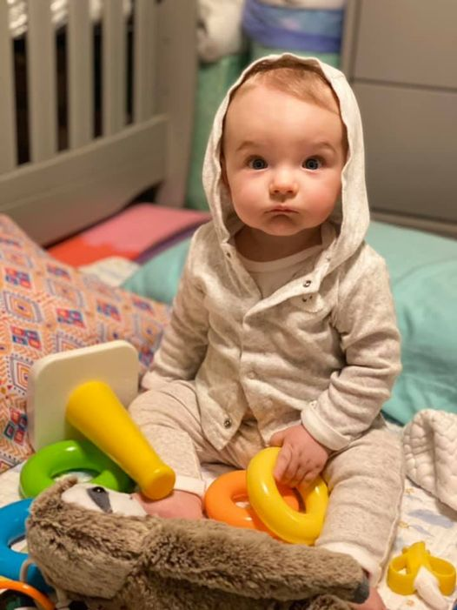
Noah in his hoody

Slide 5
Prayer and Announcements
Sundays Facebook Live or In-person:
9:15 Small Group Sunday School Classes
10:30 Worship
--------------------------------
Mask in and Mask out...

Slide 7
BEGIN HERE December 2, 2020
Week 27 – Revelation 19
Hallelujah

Slide 8
Revelation 19:1-6.. Hallelujah Chorus
1 After these things I heard something like a loud voice of a great multitude in heaven, saying,
“Hallelujah! Salvation, glory, and power belong to our God, 2 because His judgments are true and righteous; for He has judged the great prostitute who was corrupting the earth with her sexual immorality, and He has avenged the blood of His bond-servants on her.”
Notes:
Hallelujah = Praise the Lord!!
Salvation, ➔ No other Name given to be saved (Acts 4); No power can rescue from His ominipotent hand
Glory, ➔ only His because He is CREATOR; Sustainer; Savior; Rescuer; Righteous Avenger;
and Power ➔ Opens and no one can shut; Shuts and no one can open (rev 3:7)
belong to God ➔ they are His and His alone!
BECAUSE
His Judgments are true and righteous
Judged the prostitute (for corrupting the earth)
Avenged the blood of His bond servants

Slide 9
Revelation 19:1-6 cont.. Hallelujah Chorus
3 And a second time they said, “Hallelujah! Her smoke rises forever and ever.” 4 And the twenty-four elders and the four living creatures fell down and worshiped God who sits on the throne, saying, “Amen. Hallelujah!” 5 And a voice came from the throne, saying,
“Give praise to our God, all you His bond-servants, you who fear Him, the small and the great.”
Notes:
A second time ➔ emphasis! A new group of worshippers even closer to the throne !
24 elders and 4 living creatures: representatives of the totality of God’s people and the animal and spirit world?
Amen ➔ a word of assent or agreement
Hallelujah ➔ an exclamation of worship and praise
Give praise to our God, all you His bond-servants, you who fear Him, the small and the great ➔ All Heaven calls All of God’s people to give Him praise and awe

Slide 10
Revelation 19:1-6 cont. Hallelujah Chorus
6 Then I heard something like the voice of a great multitude and like the sound of many waters, and like the sound of mighty peals of thunder, saying,
“Hallelujah! For the Lord our God, the Almighty, reigns.
Notes:
HALLELUJAH CHORUS (from Handel’s Messiah):
“Hallelujah! For the Lord our God, the Almighty, reigns.
Reigns ➔ aorist (could be inceptive meaning He has begun to reign... It has started)

Slide 11
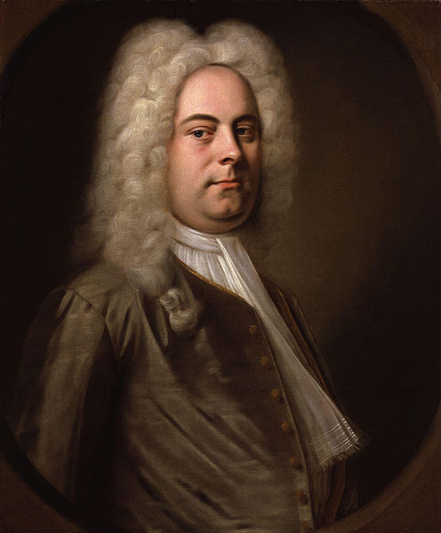
Revelation 19:6 KJV Hallelujah Chorus
Hallelujah!
for the Lord God omnipotent reigneth.
This audio is part of the collection: Open Source Audio Artist/Composer: National Park Service (NPS) Creative Commons license: Public Domain
Notes:
HALLELUJAH CHORUS (from Handel’s Messiah):
“Hallelujah! For the Lord our God, the Almighty, reigns.

Slide 12
Revelation 19:7-9 Wedding Feast of the Lamb
7 Let’s rejoice and be glad and give the glory to Him, because the marriage of the Lamb has come, and His bride has prepared herself.” 8 It was given to her to clothe herself in fine linen, bright and clean; for the fine linen is the righteous acts of the saints.
9 Then he said to me, “Write: ‘Blessed are those who are invited to the wedding feast of the Lamb.’” And he *said to me, “These are the true words of God.”
Notes:
Let’s rejoice and be glad and give the glory to Him, ➔ Two forms of worship: Being Glad and Giving Glory
Both are important. And both are commanded!
because the marriage of the Lamb has come, and His bride has...
DEBATE: All God’s Work or Our Work == YES!
prepared herself.” ➔ the church should prepare itself to meet Christ
8 It was given to her ➔ We have nothing that we did not receive
to clothe herself in fine linen, bright and clean; ➔ get dressed in the fine linen
for the fine linen is the righteous acts of the saints. ➔ righteous acts are what we are supposed to do, but prepared beforehand by God (Ephesians 2:10 “For we are God’s handiwork, created in Christ Jesus to do good works, which God prepared in advance for us to do.” NIV)
Eph. 5:25 Husbands, love your wives, just as Christ also loved the church and gave Himself up for her, 26 so that He might sanctify her, having cleansed her by the washing of water with the word,
Tyndale: (contrast the clothing of the harlot, 17:4; 18:16). Rev. 17:4 The woman was clothed in purple and scarlet, and adorned with gold and precious stones and pearls, having in her hand a gold cup full of abominations and of the unclean things of her immorality,
=➔ ➔ ➔

Slide 13
Revelation 19:7-9 Wedding Feast of the Lamb
7 Let’s rejoice and be glad and give the glory to Him, because the marriage of the Lamb has come, and His bride has prepared herself.” 8 It was given to her to clothe herself in fine linen, bright and clean; for the fine linen is the righteous acts of the saints.
9 Then he said to me, “Write: ‘Blessed are those who are invited to the wedding feast of the Lamb.’” And he *said to me, “These are the true words of God.”
Notes:
9 Then he said to me, “Write: ‘Blessed are those who are invited to the wedding feast of the Lamb.’” ➔ Have to be invited... But have been!
And he *said to me, “These are the true words of God.”
Parables about Wedding Feasts:
Matthew 22 People invited did not want to come... So others were gathered... One came without proper attire and was cast out
Matthew 25 Five virgins were prepared with oil for lamps, but five were not and missed out when the bridegroom came suddenlyl,

Slide 14
Revelation 19:10 Worship God!
10 Then I fell at his feet to worship him. But he said to me, “Do not do that; I am a fellow servant of yours and your brothers and sisters who hold the testimony of Jesus; worship God!
For the testimony of Jesus is the spirit of prophecy.”
Notes:
10 Then I fell at his feet to worship him. ➔ WHAT???? Angels are so magnificient that even the Apostle whom Jesus Loved could mistakenly worship them... WHAT DOES THAT SAY ABOUT GOD’S MAJESTY AND GLORY???!!!???
But he said to me, “Do not do that; I am a fellow servant of yours and your brothers and sisters who hold the testimony of Jesus;
worship God!
For the testimony of Jesus is the spirit of prophecy.”

Slide 15
Revelation 19:11-14 The Word of God
11 And I saw heaven opened, and behold, a white horse, and He who sat on it is called Faithful and True, and in righteousness He judges and wages war. 12 His eyes are a flame of fire, and on His head are many crowns; and He has a name written on Him which no one knows except Himself. 13 He is clothed with a robe dipped in blood, and His name is called The Word of God. 14 And the armies which are in heaven, clothed in fine linen, white and clean, were following Him on white horses.
Notes:
a white horse, ➔ a horse of warfare (as opposed to the donkey of peace for His triumphal entry)
called Faithful and True,
in righteousness He judges and wages war.
12 His eyes are a flame of fire, and ➔ represents righteous judgment
on His head are many crowns; and ➔ represents royalty and authority ➔ now the uncontested ruler of the world! (Epp)
He has a name written on Him which no one knows except Himself. ➔ ?????
13 He is clothed with a robe dipped in blood, and ➔ represents His sacrifice and righteous vengeance
Tyndale: In this book he repeatedly makes the point that it is in his capacity as the ‘Lamb as though slain’ that Christ conquers. He overcame, not by shedding the blood of others, but by shedding his own.
His name is called The Word of God. ➔ Gospel of John begins with this Name for Jesus = logos ➔ ➔ ➔ john 1:1-3, 14

Slide 16
John 1:1-3, 14 The Word (Logos)
1 In the beginning was the Word, and the Word was with God, and the Word was God. 2 He was with God in the beginning. 3 Through him all things were made; without him nothing was made that has been made.
14 The Word became flesh and made his dwelling among us. We have seen his glory, the glory of the one and only Son, who came from the Father, full of grace and truth.
Notes:
a white horse,
called Faithful and True,
in righteousness He judges and wages war.
12 His eyes are a flame of fire, and ➔ represents righteous judgment
on His head are many crowns; and ➔ represents royalty and authority
He has a name written on Him which no one knows except Himself. ➔ ?????
13 He is clothed with a robe dipped in blood, and ➔ represents His sacrifice and righteous vengence
His name is called The Word of God. ➔ Gospel of John begins with this Name for Jesus
14 And the armies which are in heaven, clothed in fine linen, white and clean, were following Him on white horses.
?? Angels?? (the heavenly host = armies of angels) ??
?? Believers?? (fine linen in vs 8 was the righteous acts of the saints) ??

Slide 17
Revelation 19:11-14 cont. The Word of God
11 And I saw heaven opened, and behold, a white horse, and He who sat on it is called Faithful and True, and in righteousness He judges and wages war. 12 His eyes are a flame of fire, and on His head are many crowns; and He has a name written on Him which no one knows except Himself. 13 He is clothed with a robe dipped in blood, and His name is called The Word of God. 14 And the armies which are in heaven, clothed in fine linen, white and clean, were following Him on white horses.
Notes:
14 And the armies which are in heaven, clothed in fine linen, white and clean, were following Him on white horses.
?? Angels?? (the heavenly host = armies of angels) ??
?? Believers?? (fine linen in vs 8 was the righteous acts of the saints) ??
*** Glen Blackmon’s favorite passage... Before he goes out to do battle as a police officer.

Slide 18
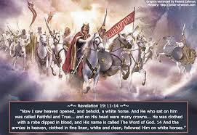

Slide 19
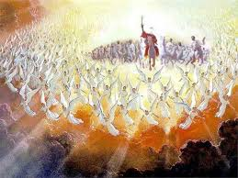

Slide 20
Revelation 19:15-16 King of Kings, Lord of Lords
15 From His mouth comes a sharp sword, so that with it He may strike down the nations, and He will rule them with a rod of iron; and He treads the wine press of the fierce wrath of God, the Almighty. 16 And on His robe and on His thigh He has a name written: “KING OF KINGS, AND LORD OF LORDS.”
Notes:
15 From His mouth comes a sharp sword, so that with it He may strike down the nations, ➔
the army rides with Him, but no one gets to fight!!!
He slays all of his enemies with a sword from His mouth ➔ POWER of the Word of God!!!
and He will rule them with a rod of iron;
and He treads the wine press of the fierce wrath of God, the Almighty.
16 And on His robe and on His thigh He has a name written: “KING OF KINGS, AND LORD OF LORDS.” (more of Handel’s Messiah Hallelujah Chorus)

Slide 21
Revelation 19:17-18 The Great Feast of Wrath
17 Then I saw an angel standing in the sun, and he cried out with a loud voice, saying to all the birds that fly in midheaven, “Come, assemble for the great feast of God, 18 so that you may eat the flesh of kings and the flesh of commanders, the flesh of mighty men, the flesh of horses and of those who sit on them, and the flesh of all people, both free and slaves, and small and great.”
Notes:
an angel standing in the sun,
to all the birds that fly in midheaven, “Come, assemble for the great feast of God,
18 so that you may eat the flesh of kings and the flesh of commanders,
the flesh of mighty men, the flesh of horses and of those who sit on them,
and the flesh of all people, both free and slaves, and small and great.”

Slide 22
Revelation 19:19 Assembling for War
19 And I saw the beast and the kings of the earth and their armies, assembled to make war against Him who sat on the horse, and against His army.

